Slide 2
QUATRA 1000/2000 local software update
Version 07

Slide 3
QUATRA 1000/2000 need for local update
After 28th October 2023, QUATRA 1000/2000 Network Units require these software images, in order to communicate with the Wave Cloud:
NU software: 700N036-xxx-057 (where xxx is a region-dependent 3-digit number)
NU PIC: 700N046-003-048
Earlier versions of these images will block the NU from Wave Cloud access.
The corresponding Coverage Units software images are:
CU software: 700N036-xxx-057 (where xxx is a region-dependent 3-digit number)
CU PIC: 700N040-002-070

Slide 4
QUATRA 1000 behavior depending on NU/CU versions
NU | NU PIC | CU | CU PIC | Notes
700N036-033-055 and earlier | 700N046-003-047 and earlier | 700N036-033-055 and earlier | 700N040-002-070 | System cannot communicate with the cloud. Update NUs and CUs with the Wave Field Tool
700N036-033-055 and earlier | 700N046-003-047 and earlier | 700N036-033-056 | 700N040-002-070 | System cannot communicate with the cloud. Update NUs with the Wave Field Tool. Connect the system to the cloud, and CUs will update
700N036-033-056 | 700N046-003-048 | 700N036-033-056 | 700N040-002-070 | CU will update to 57, NU will update to 57
700N036-033-057 | 700N046-003-048 | 700N036-033-056 | 700N040-002-070 | CU will update to 57
700N036-033-056 / 700N036-033-057 | 700N046-003-048 | 700N036-033-055 and earlier | 700N040-002-070 | CU will not update (‘stranded’ CU). In this case the system will function, but the cloud will continually attempt to update the CUs and fail. The repeated updates will sometimes cause management actions to fail. Options: Manually update the CUs with the Wave Field Tool Wait for Nextivity software update in 2024, to cure the CU update failure.

Slide 5
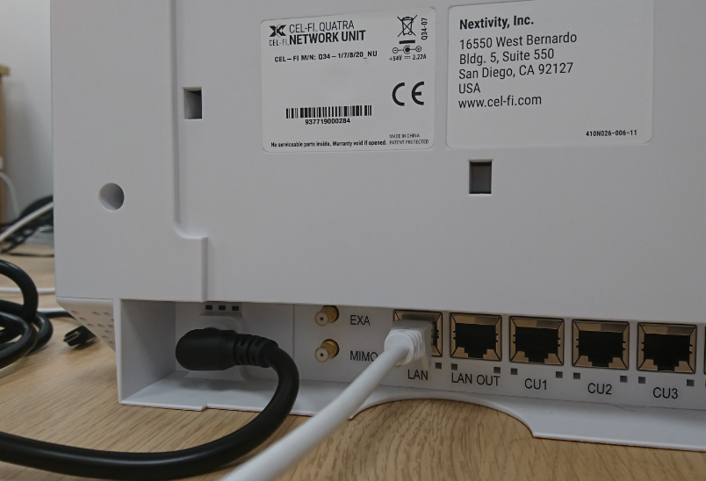
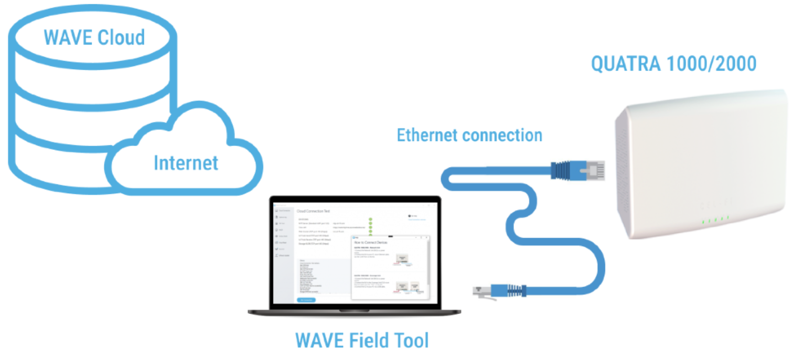
QUATRA 1000/2000 update with Wave Field Tool (WFT)
You need a PC with 2 networking connections (typically a laptop PC with Ethernet LAN and Wi-Fi interfaces)
The WiFi must provide an Internet connection
The LAN port must be set for DHCP (automatic IP address allocation)
The user logged into the PC must have administrative privileges, on that PC (have the ability to install software and change system settings)

Slide 6
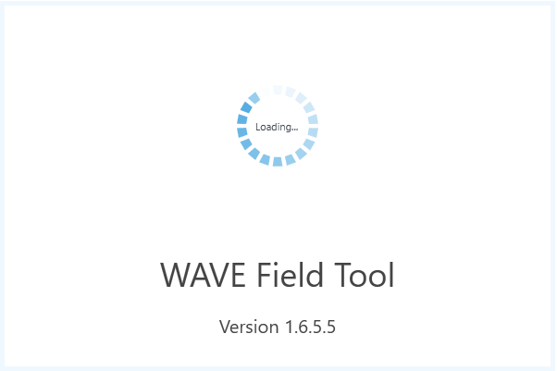
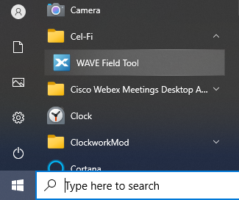
Minimum WFT version – 1.6.6.8
Wave Field Tool 1.6.6.8 must be used for the update
Earlier versions must be un-installed first
This is older than 1.6.6.8, therefore it must be un-installed

Slide 7
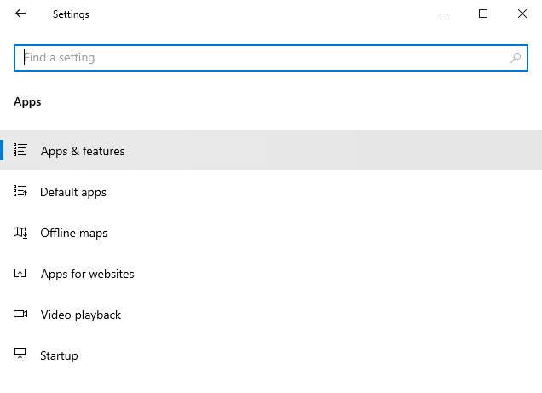
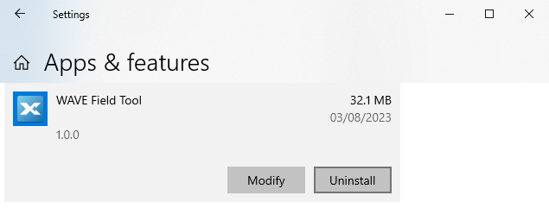
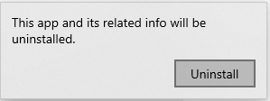
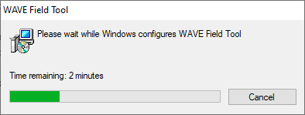
Un-install any previous WFT versions

Slide 8
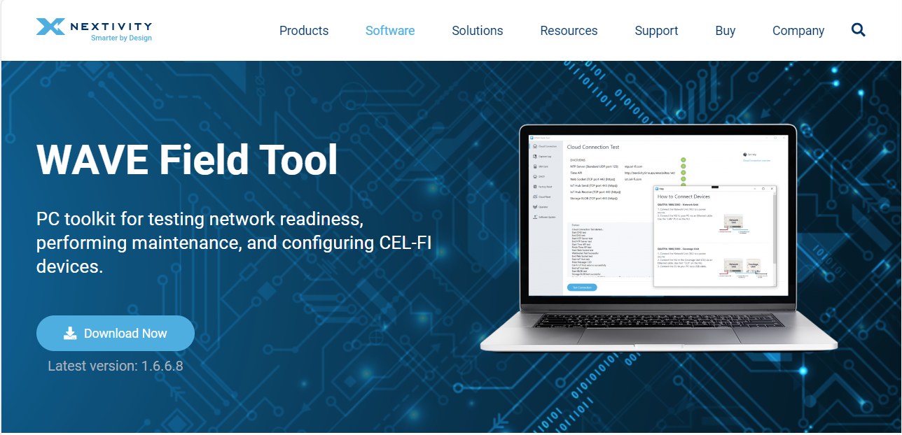
Download the latest version
Download link: https://nextivityinc.com/software/wavefieldtool/

Slide 9
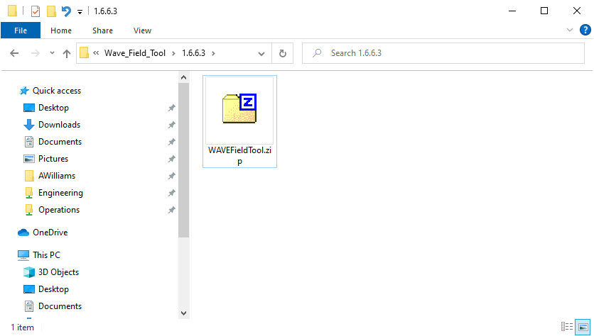
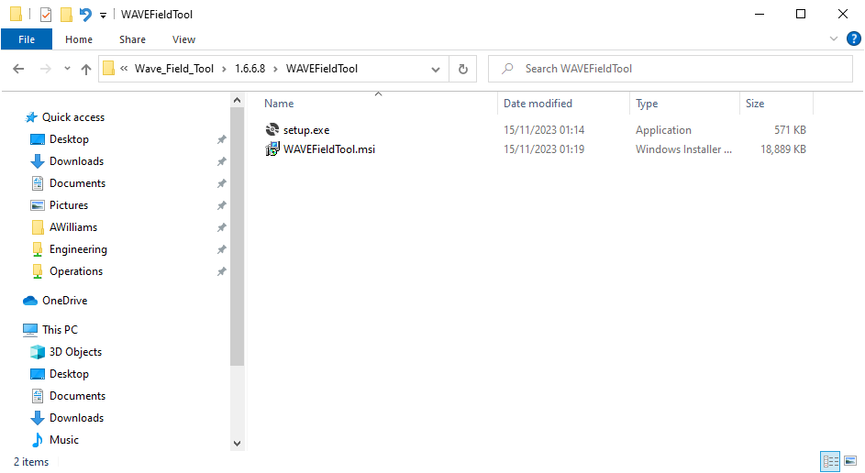
Extract setup.exe & PCFieldTool.msi from WAVEFieldTool.zip
Then double-click setup.exe to install WFT 1.6.6.8

Slide 10
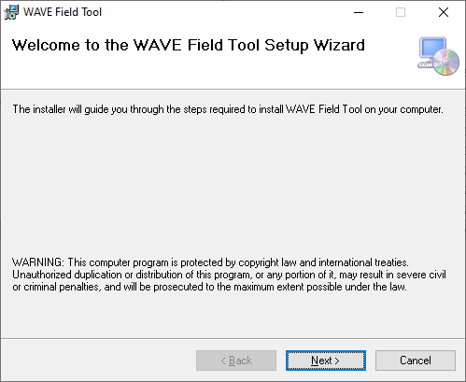
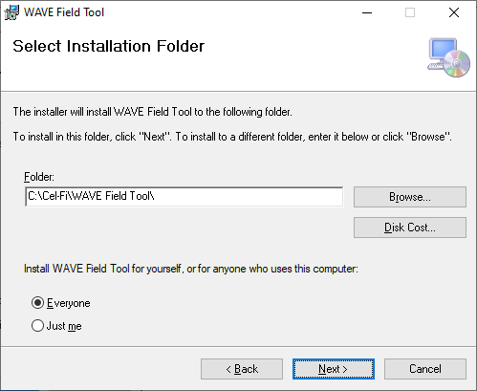
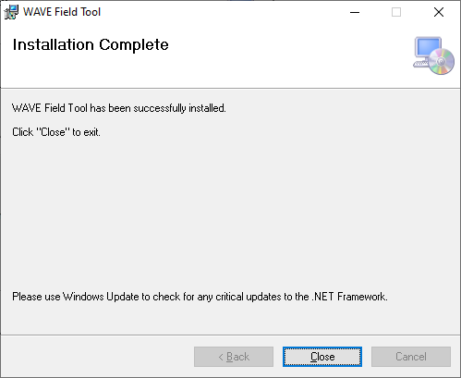
Confirm the installation questions, during the install

Slide 11
Network Unit

Slide 12
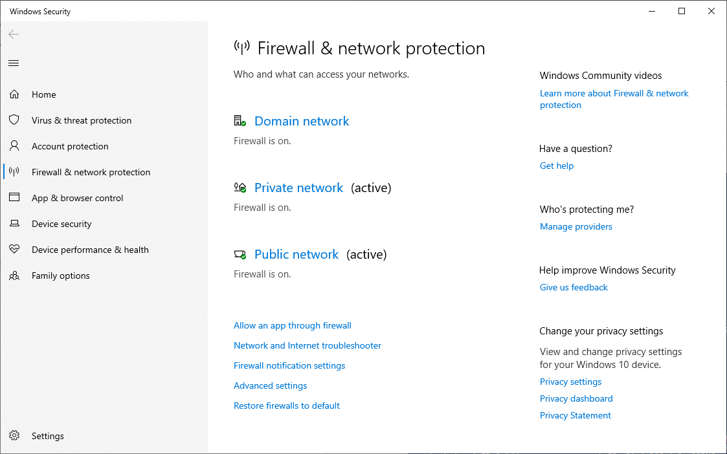
While running WFT, you may have to disable Windows Firewall
When using WFT over Ethernet to Q1000 NU, it will most likely assume it is a Public network interface, so that will probably be the one you have to disable the firewall on

Slide 13
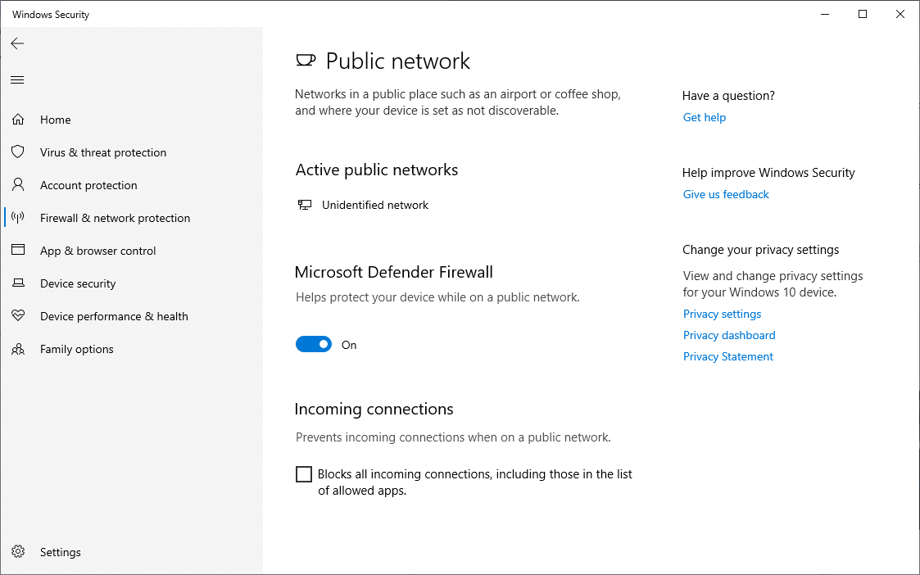
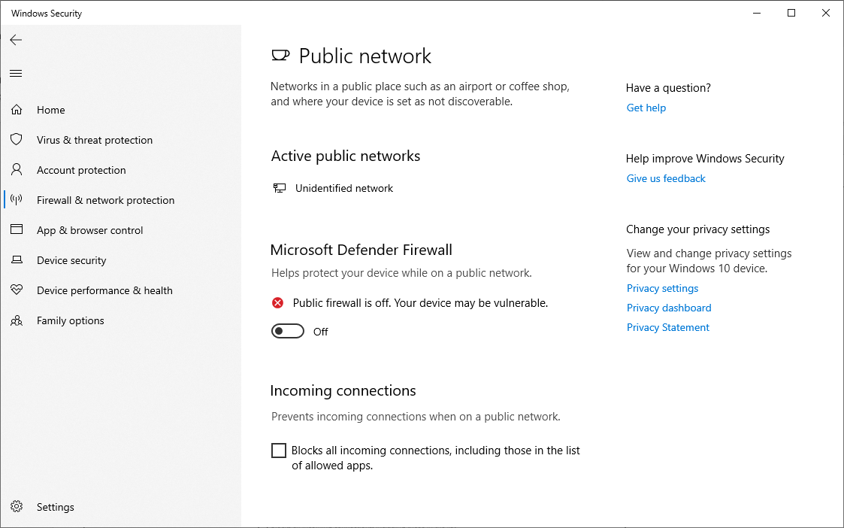
Disable Windows Firewall (remember to turn back on after)

Slide 14
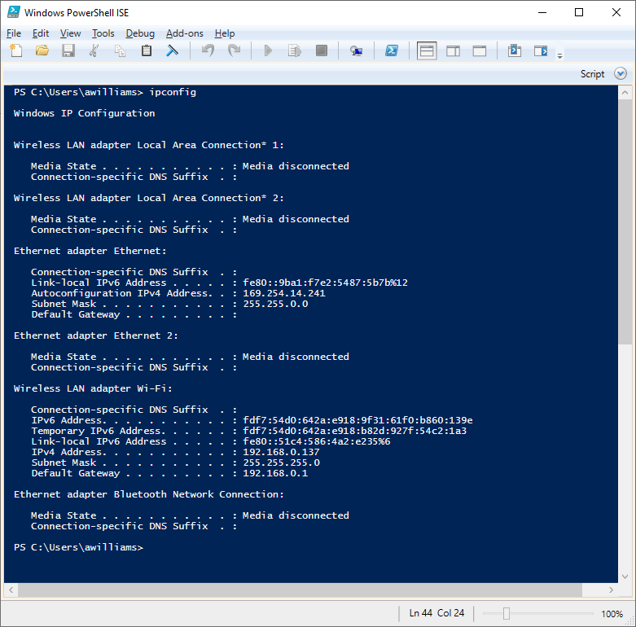
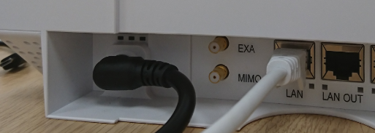
Ethernet interface IP address
If your Ethernet interface is configured for automatic IP address allocation, when you plug it into the Q1000 NU Ethernet port, it will get an Autoconfiguration IPv4 address (169.254.x.x)

Slide 15
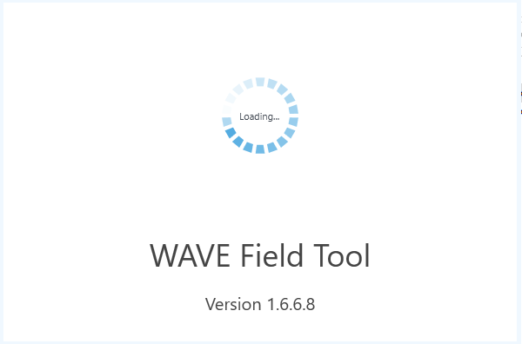
Run WFT – ensure it is at least version 1.6.6.8

Slide 16
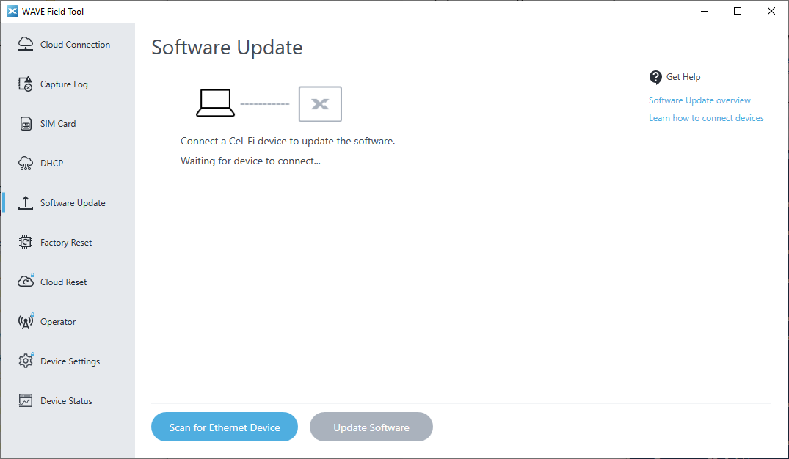
Select Software Update
Press Scan for Ethernet Device

Slide 17
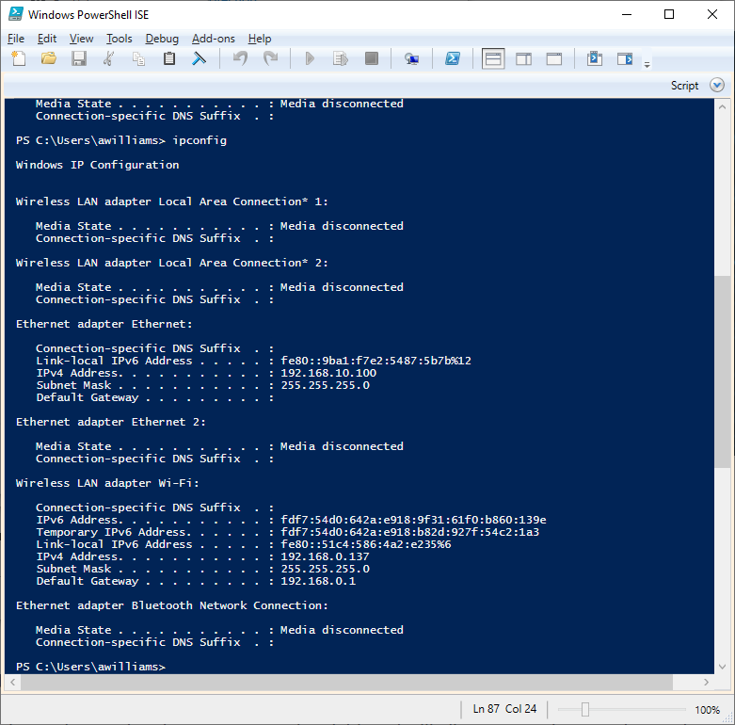
WFT sets a static IP address on the Ethernet interface: 192.168.10.100
You will be asked for confirmation as an admin, to change the system settings.

Slide 18
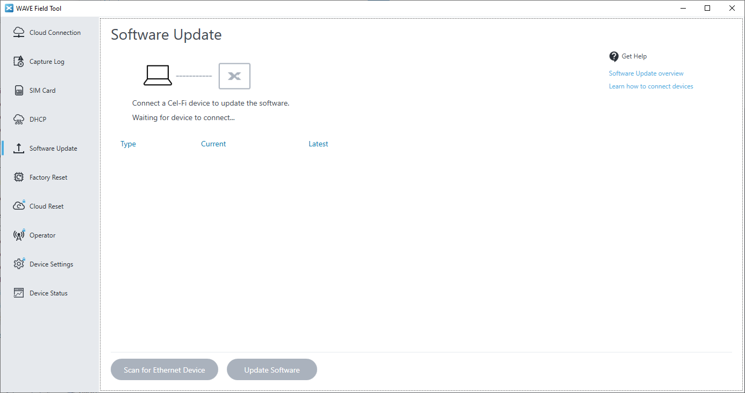
Scan for Ethernet Device

Slide 19
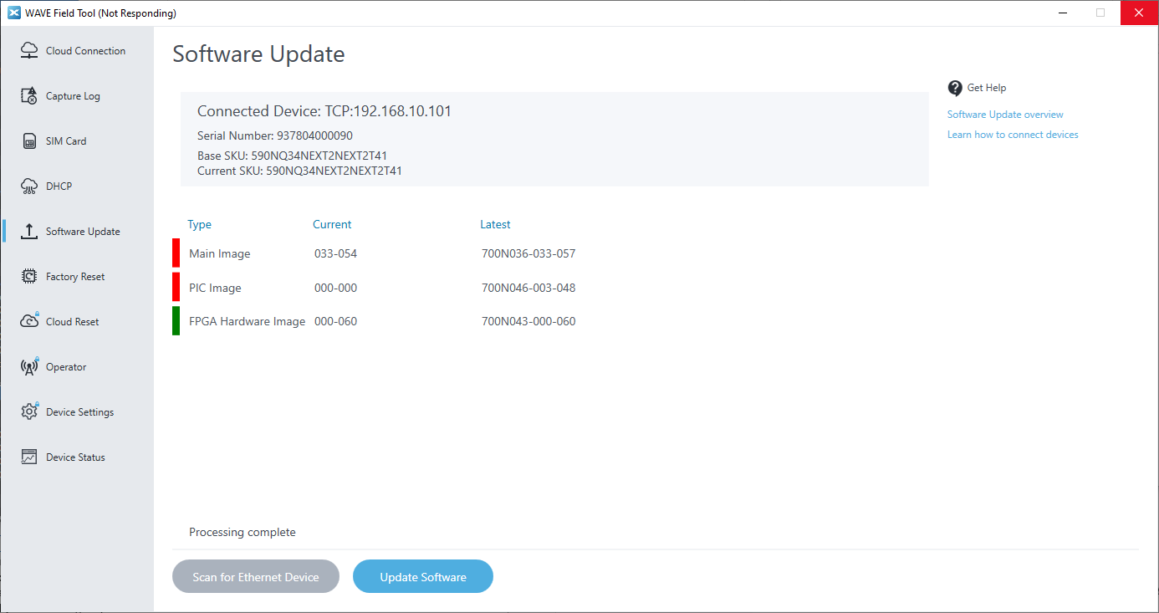
Only Main Image, PIC Image and FPGA Hardware Image should be offered for update
If you are offered additional images, then you are probably running the wrong version of WFT
You should re-install the correct version

Slide 20
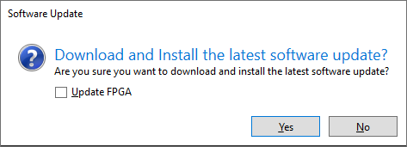
FPGA Hardware Image is not usually required
When you select Update Software, the dialog box has a check-box for Update FPGA.
FPGA update is not usually required, even if it is showing an out-of-date version.
If you choose to do FPGA update, it takes about 10 minutes, compared to about 3 minutes without the FPGA update

Slide 21
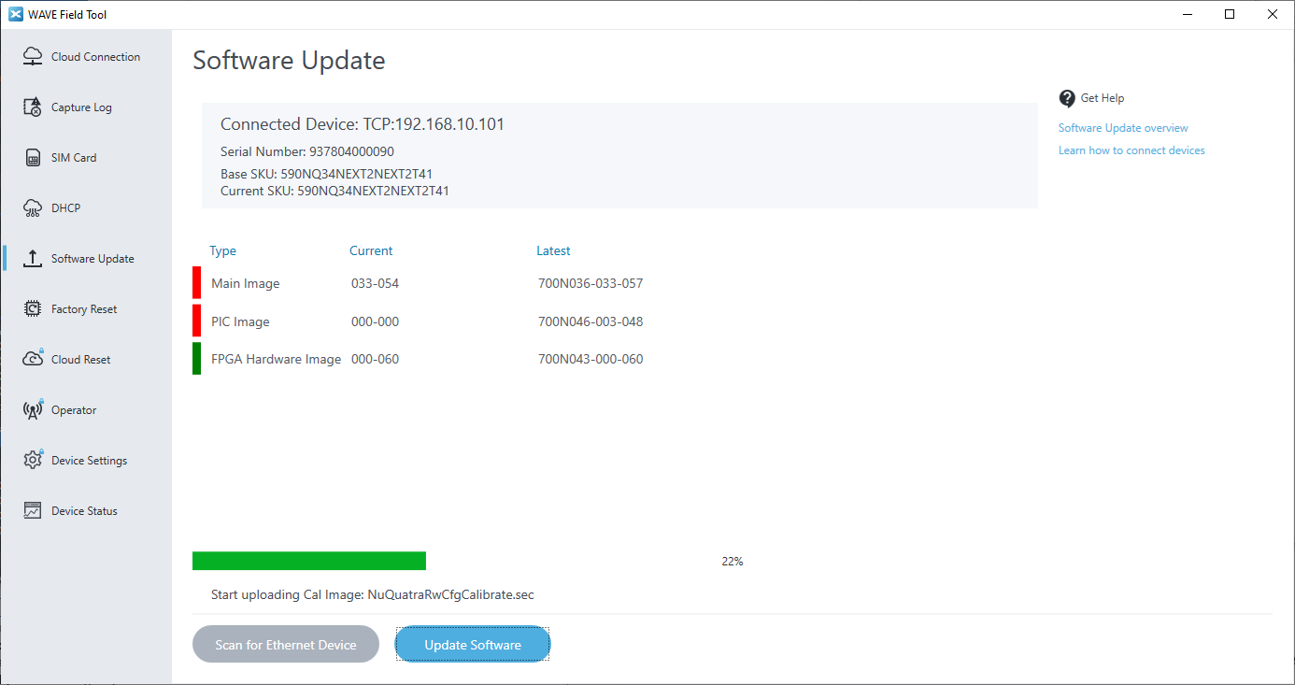
Update progress…

Slide 22
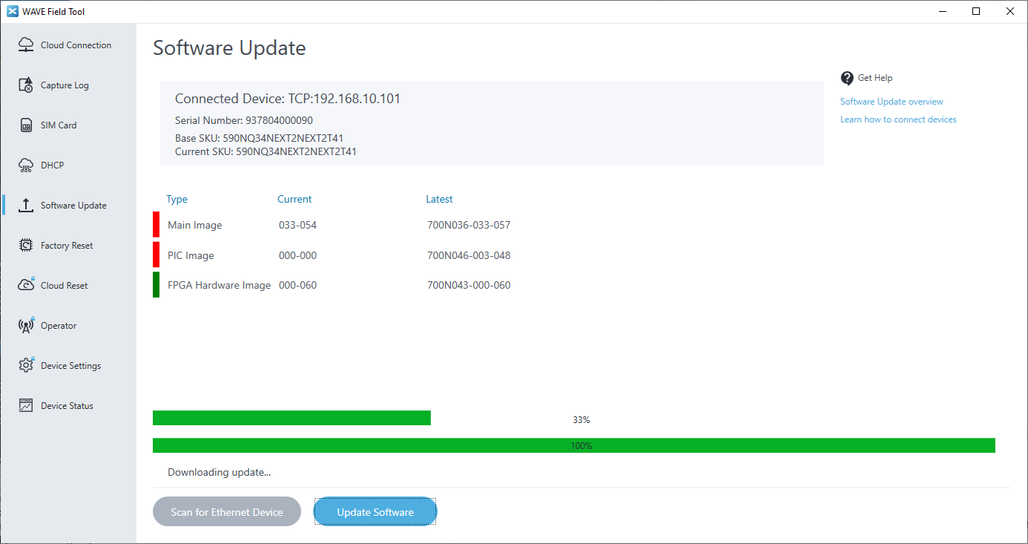
Update progress…

Slide 23
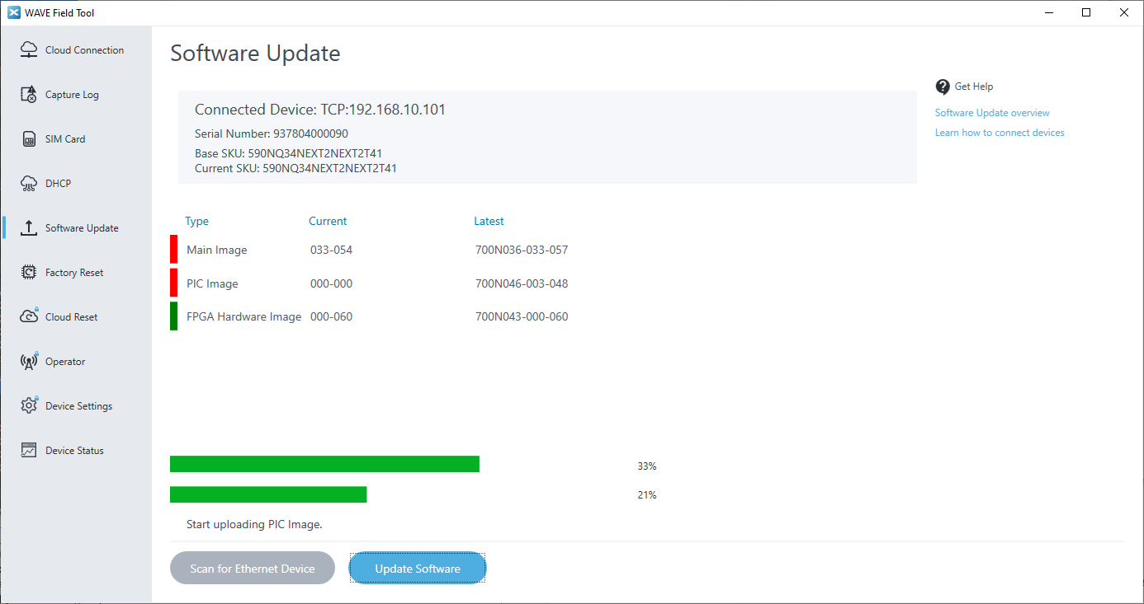
Update progress…

Slide 24
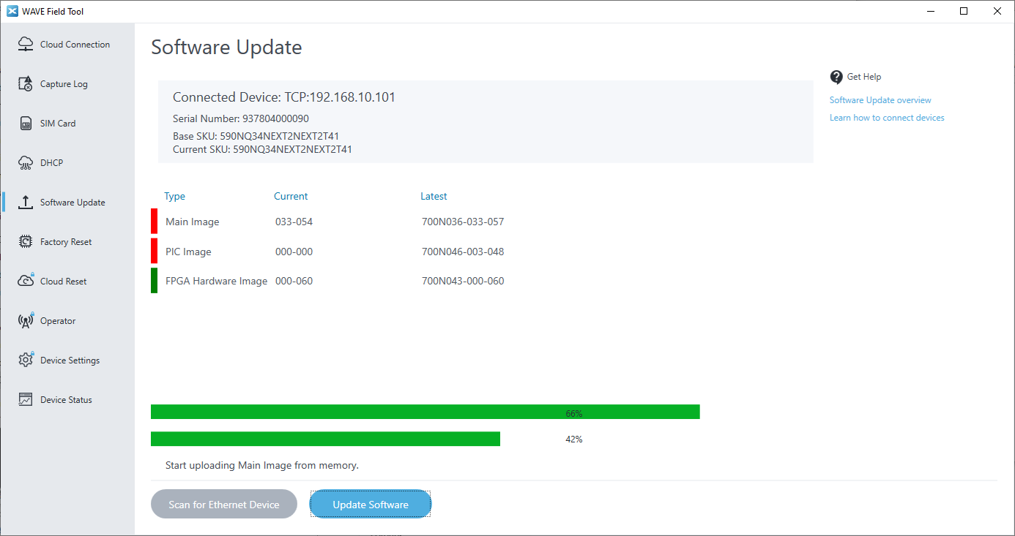
Update progress…

Slide 25
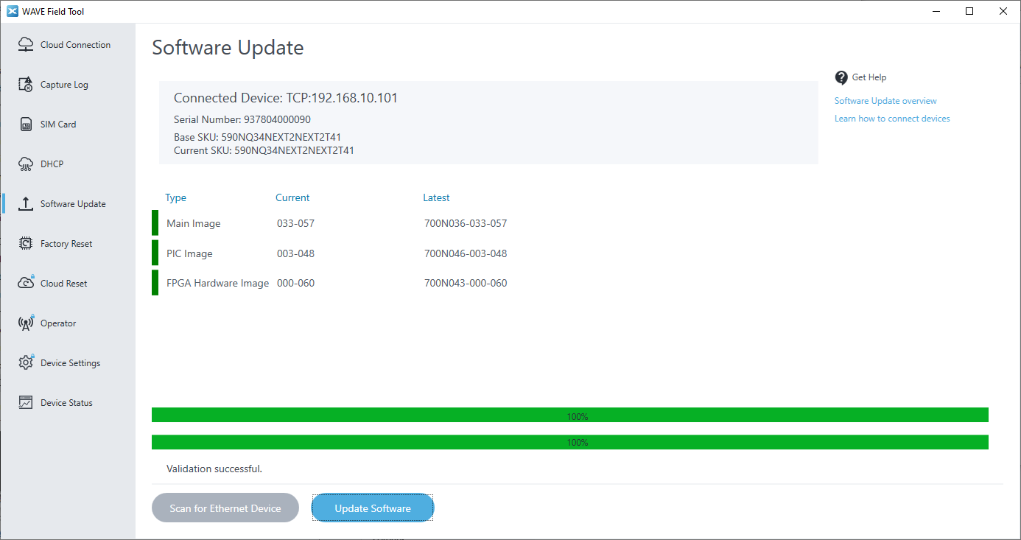
Update Complete
Note: if FPGA update was not selected, you may get a “Validation failed” message. In that case, the unit should still work (unless it previously had a corrupted FPGA image)

Slide 26
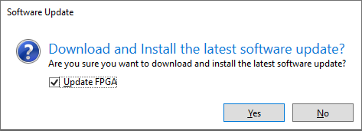
Note on FPGA Hardware Image Update
Some devices may have a corrupted NU FPGA hardware image
In this case you should select the FPGA Update option when prompted
The update in this case will take approximately 10 minutes

Slide 27
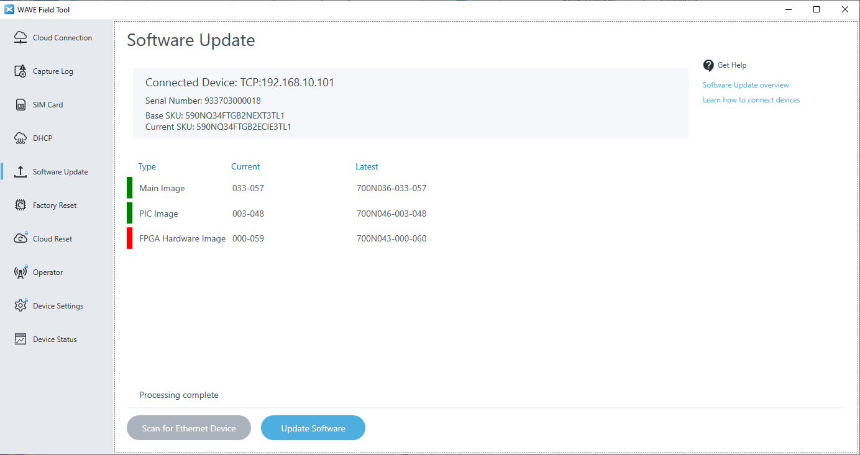
Confirmation dialog
When you select Update Software, the dialog box has a check-box for Update FPGA.

Slide 28
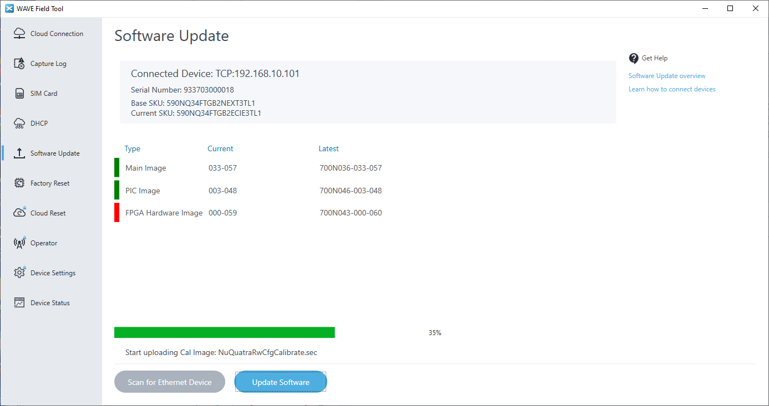
Update progress…

Slide 29
Update progress…

Slide 30
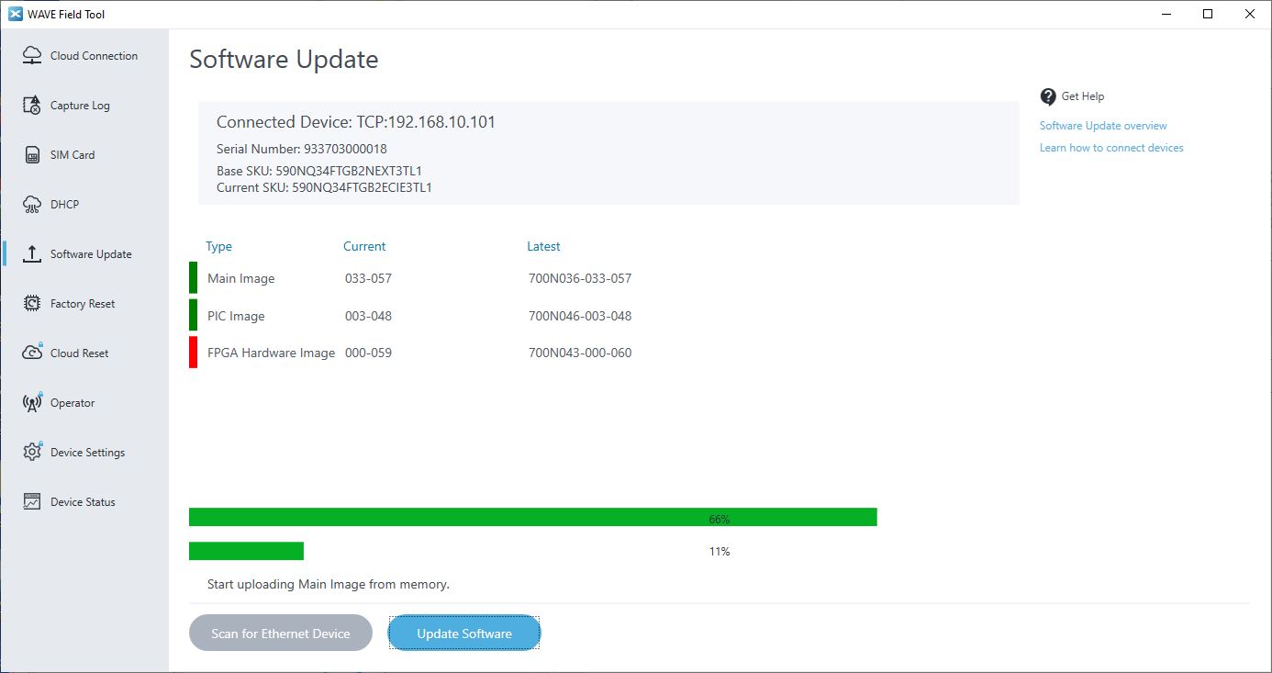
Update progress…

Slide 31
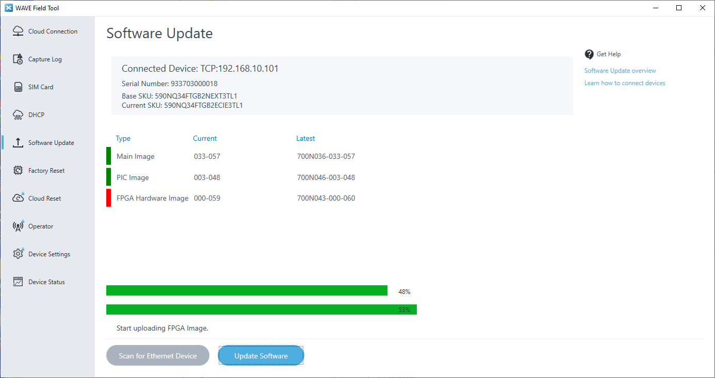
Update progress…

Slide 32
Update Complete

Slide 33
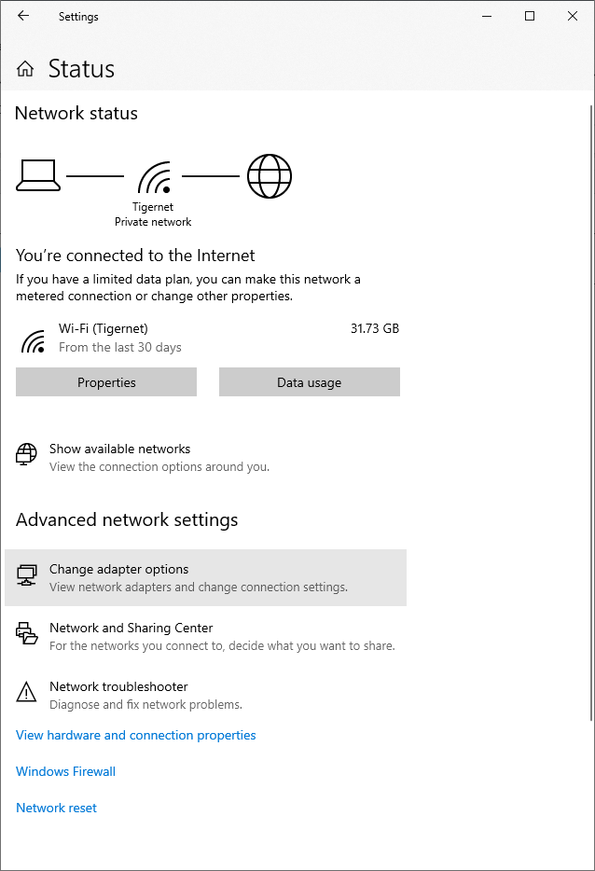
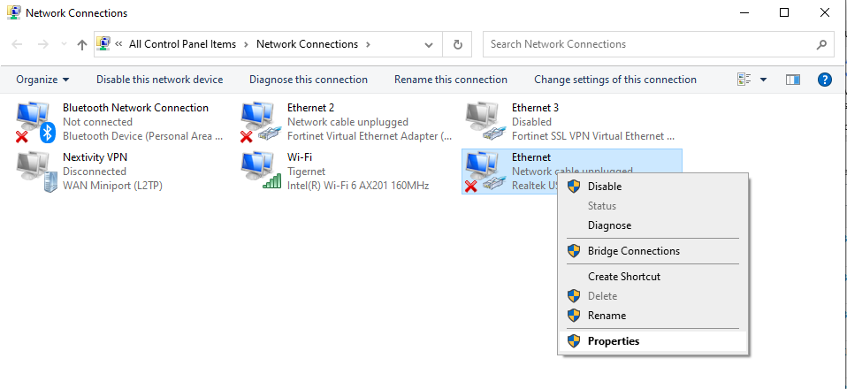
Set Ethernet Interface back to automatic IP address
After updating all the NUs you plan to update, you must manually reset the IPv4 settings on the Ethernet interface

Slide 34
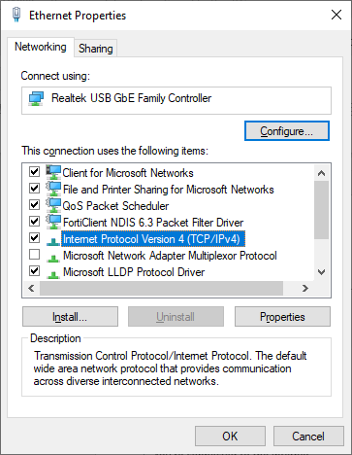
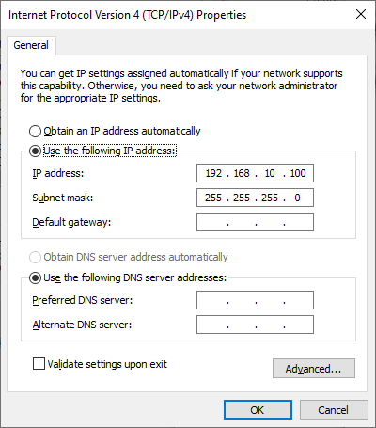
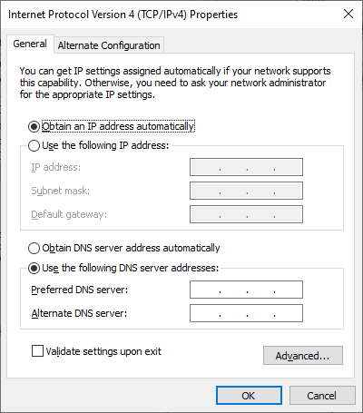
Set Ethernet Interface back to automatic IP address

Slide 35
Coverage Unit

Slide 36
CU Update - options
CU update is not mandatory
However, if you do not update the CU software, then if it has software older than version 56, it will not be updatable via the cloud
That may be corrected in a future NU software update
CU software update is relatively slow (typically ~5 minutes)
If you decide to do CU software updates:
Connect your PC directly to the CU via micro-USB
Power the CU via Ethernet, from an NU
Re-start WFT, if you used it previously on NUs

Slide 37
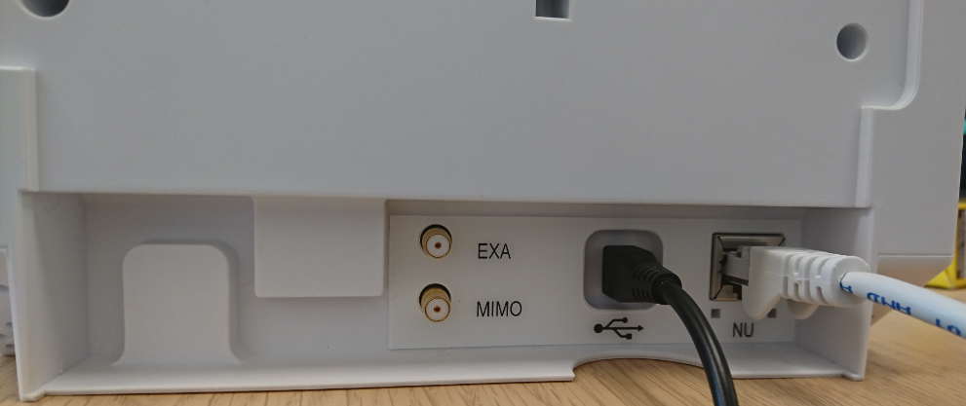
CU connections for WFT

Slide 38
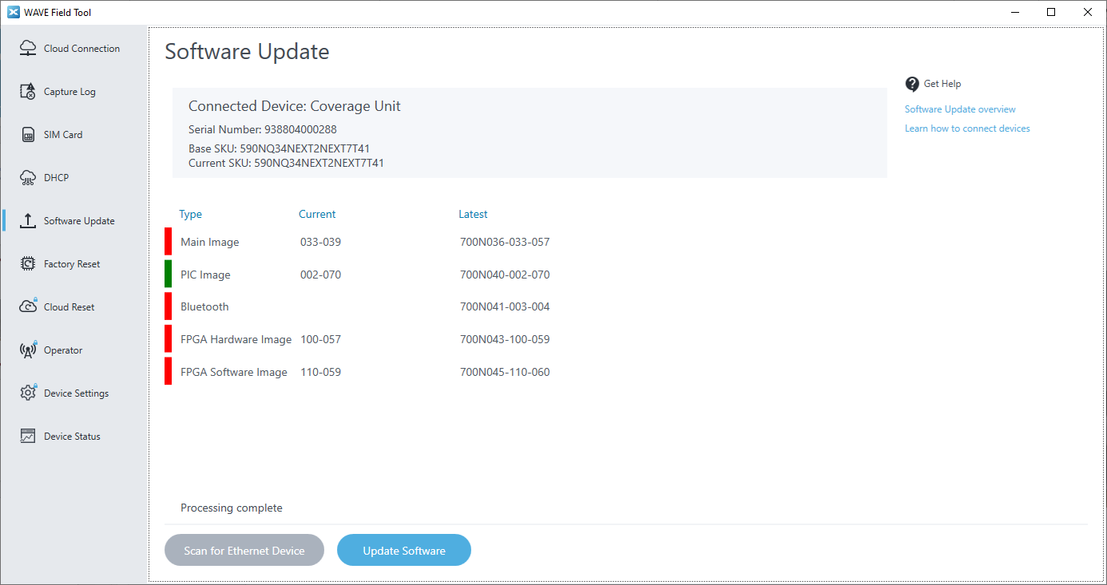
Run WFT: once synchronized, press Update Software

Slide 39
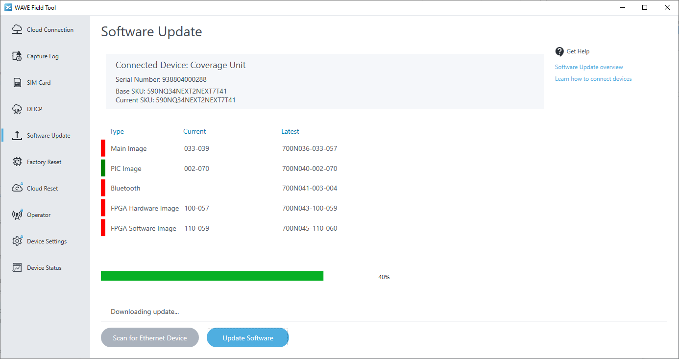
Update progress…

Slide 40
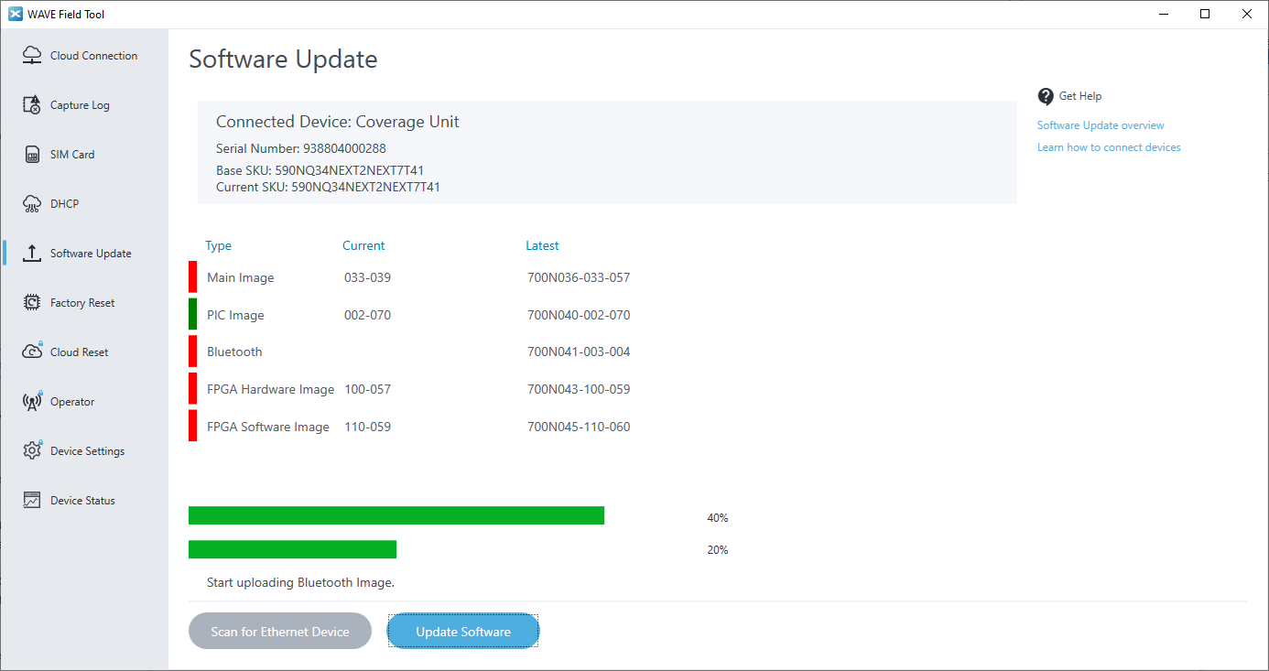
Update progress…

Slide 41
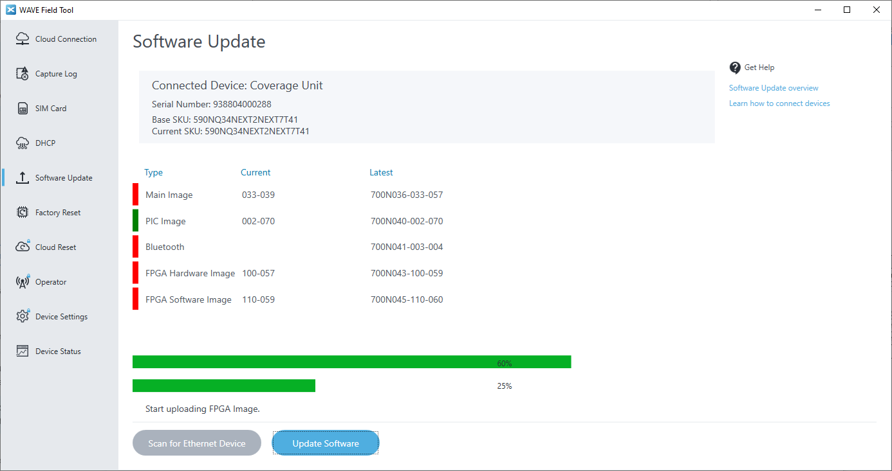
Update progress…

Slide 42
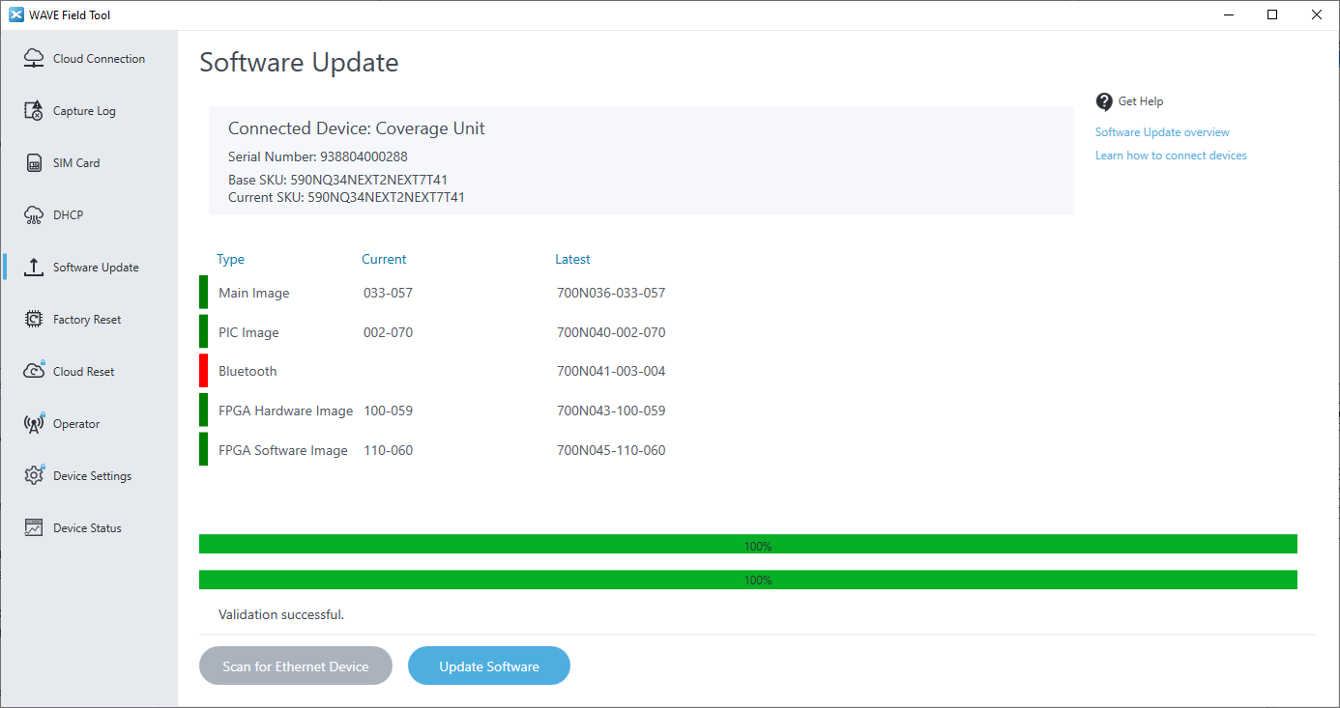
Update Complete (Bluetooth image update not essential)

Slide 43
Thank you

